Slide 1
Name: Mohiuddin
Trainee ID: 1282547
Batch: WDPF/TCLK-M/60/01

Slide 2
Project Name:
Car Rental Management System

Slide 3
Project Features

Slide 4
Frontend React
&
Backend Laravel

Slide 5
Project Frontend

Slide 6
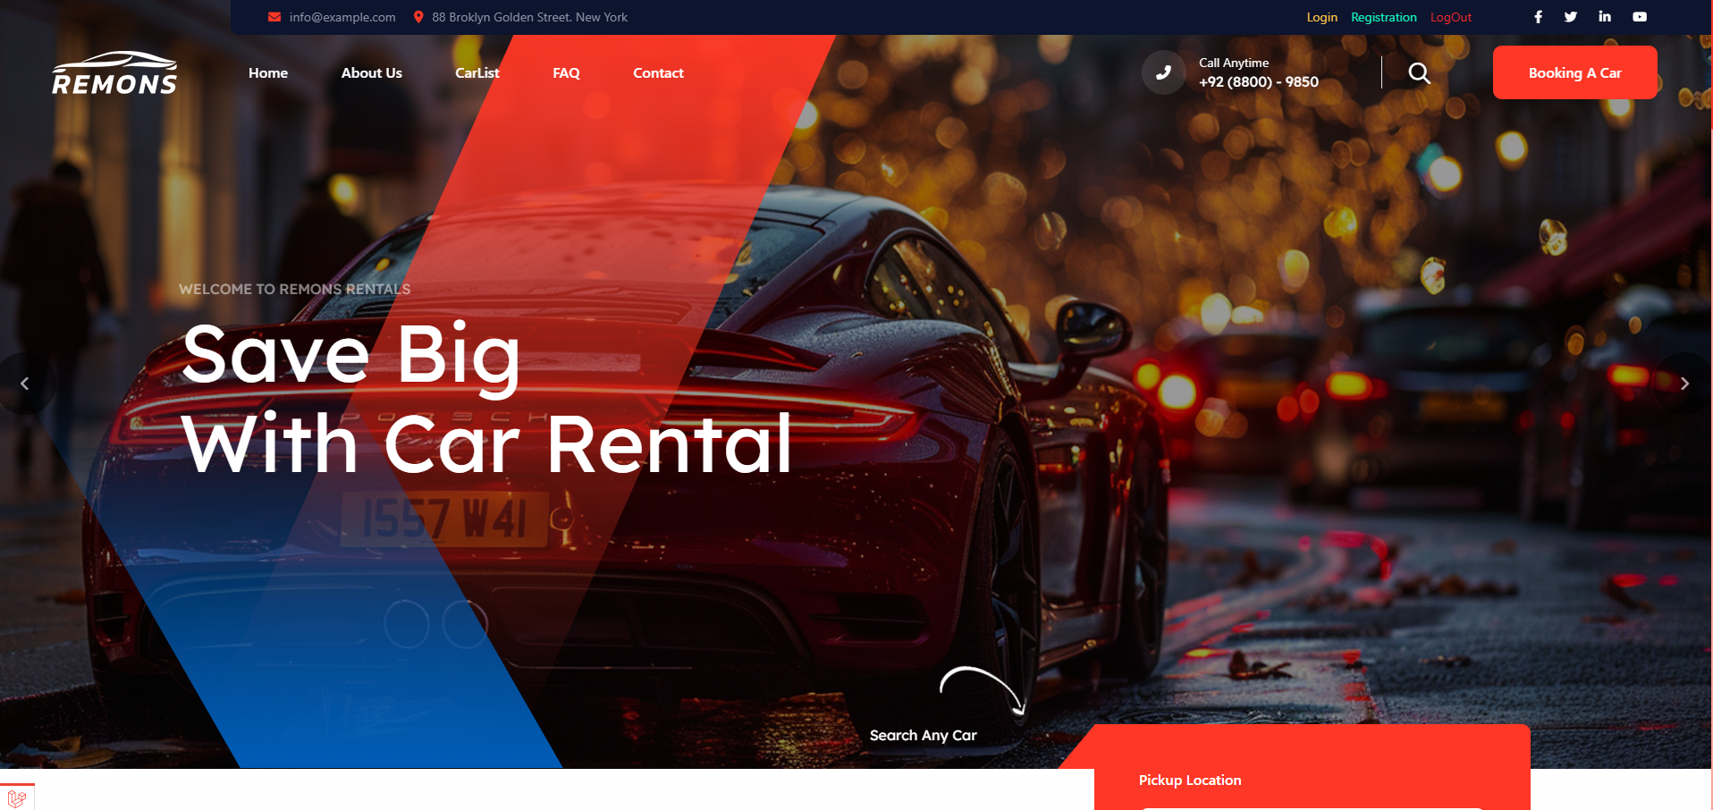

Slide 7
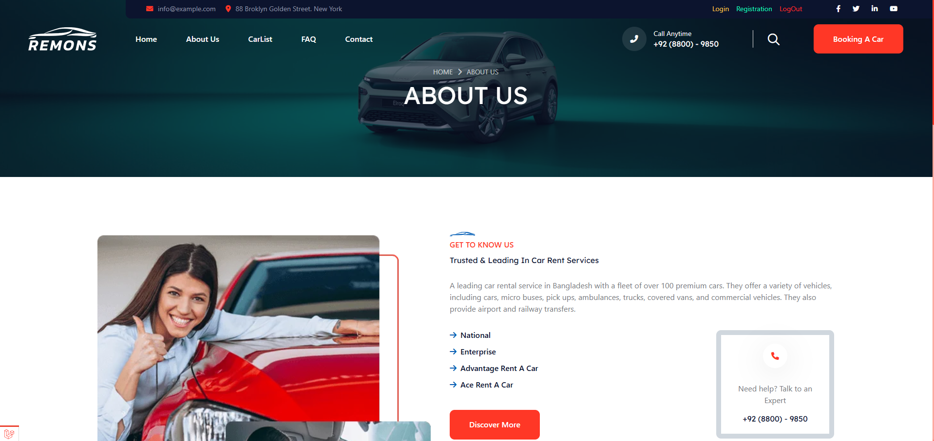

Slide 8
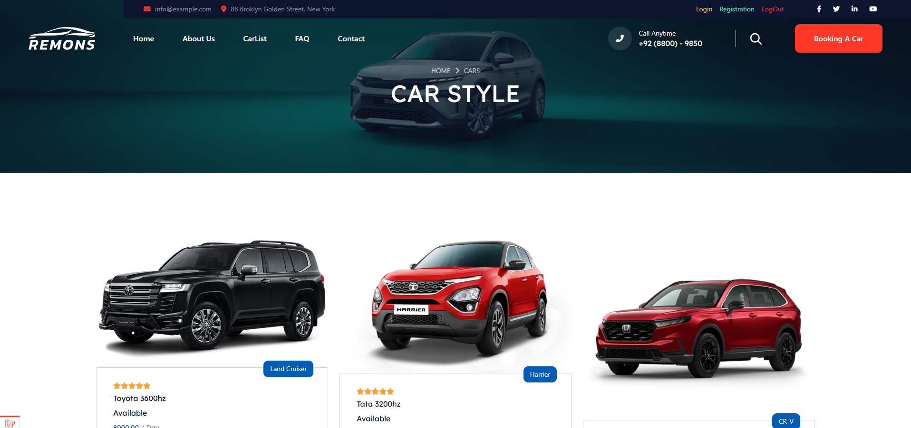

Slide 9
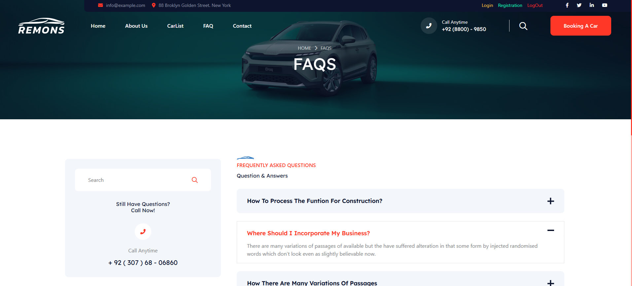

Slide 10
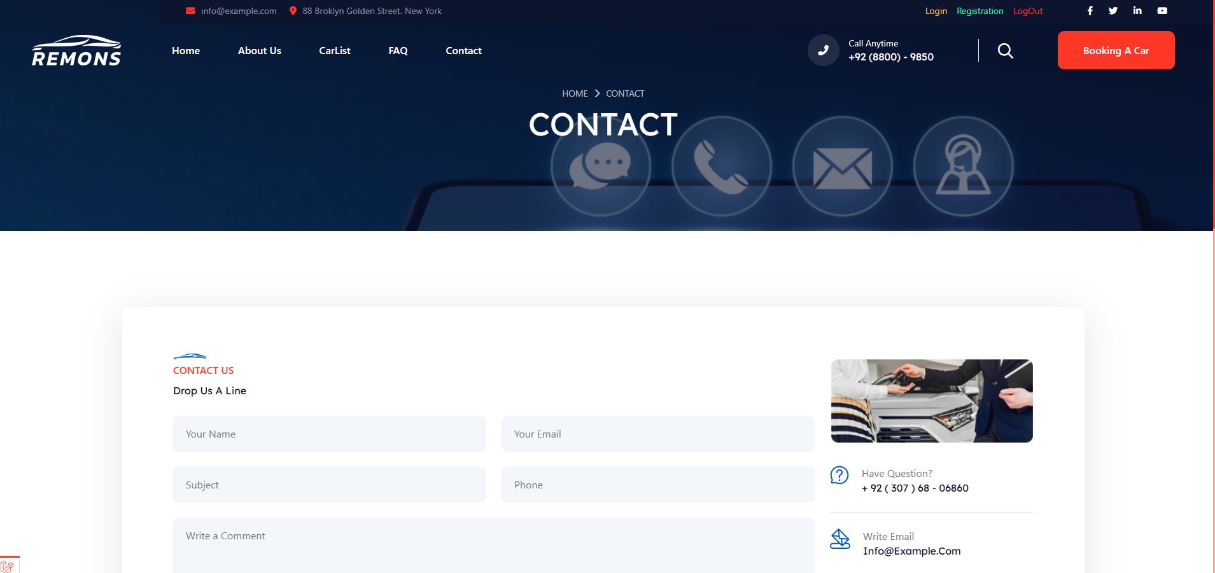

Slide 11
User Registration Form

Slide 12
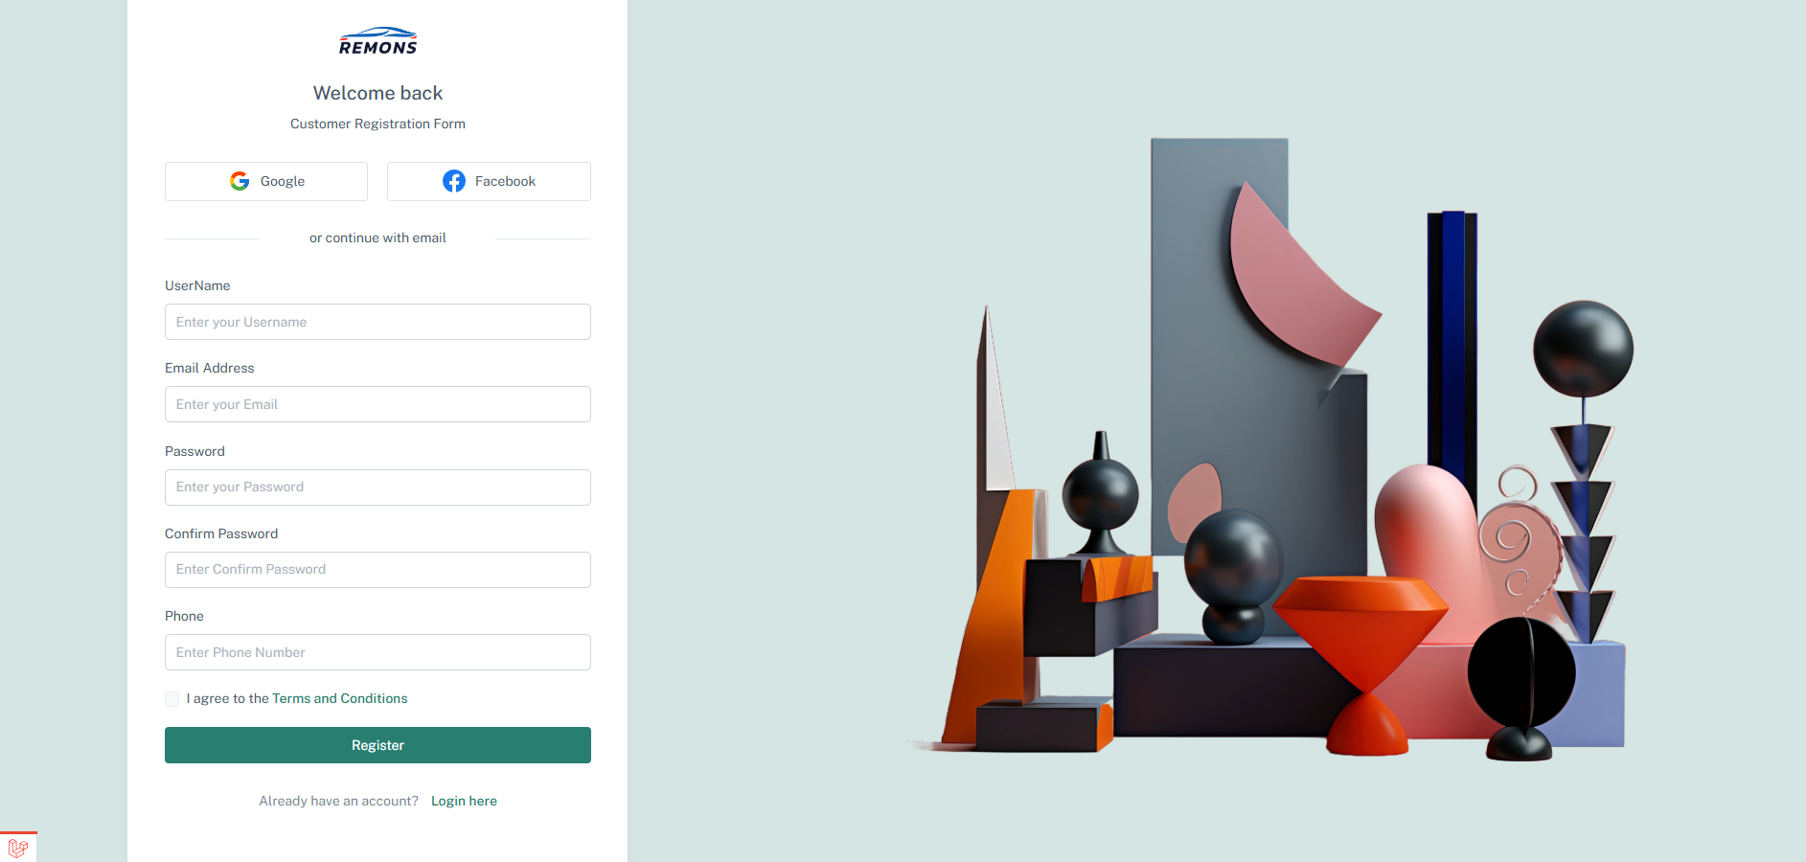

Slide 13
User Login Form

Slide 14


Slide 15
User Car Booking

Slide 16
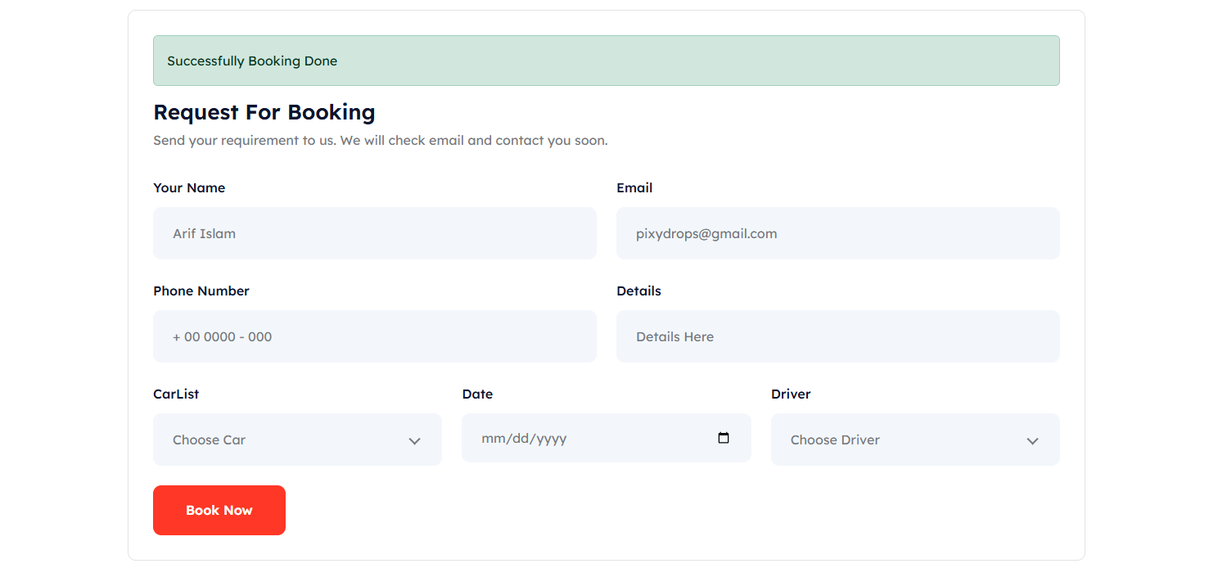

Slide 17
User Payment Invoice

Slide 18
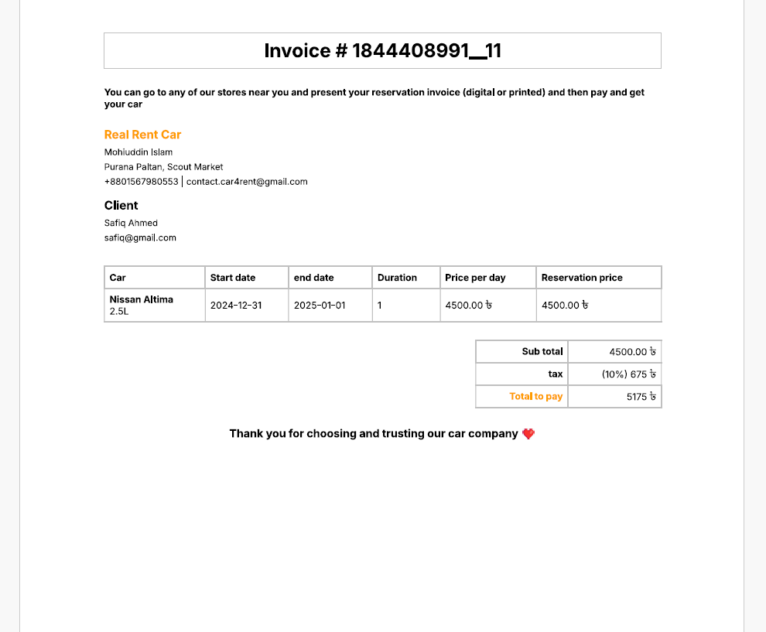

Slide 19
Car List

Slide 20
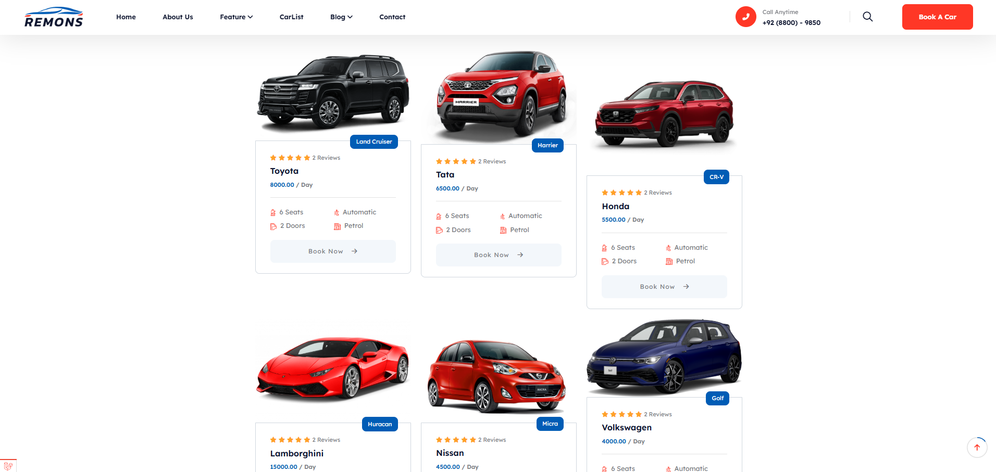

Slide 21
Admin Login

Slide 22
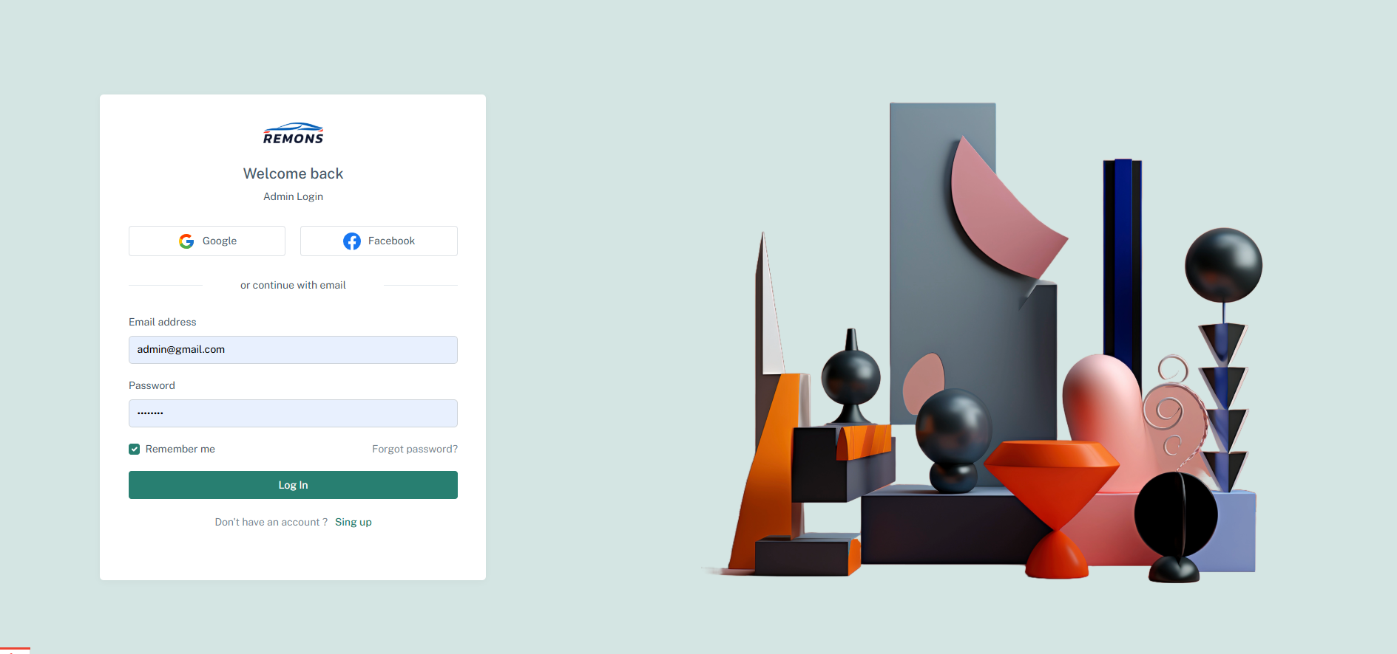

Slide 23
Admin Dashboard

Slide 24
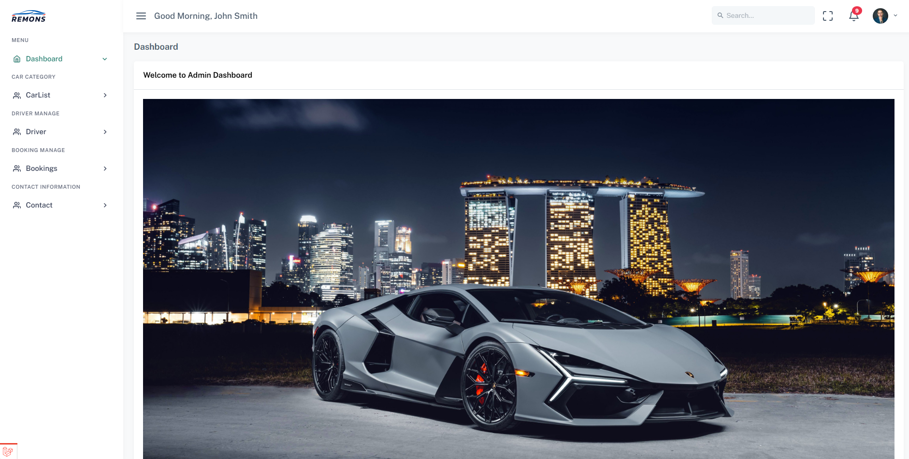

Slide 25
Admin Car Manage

Slide 26
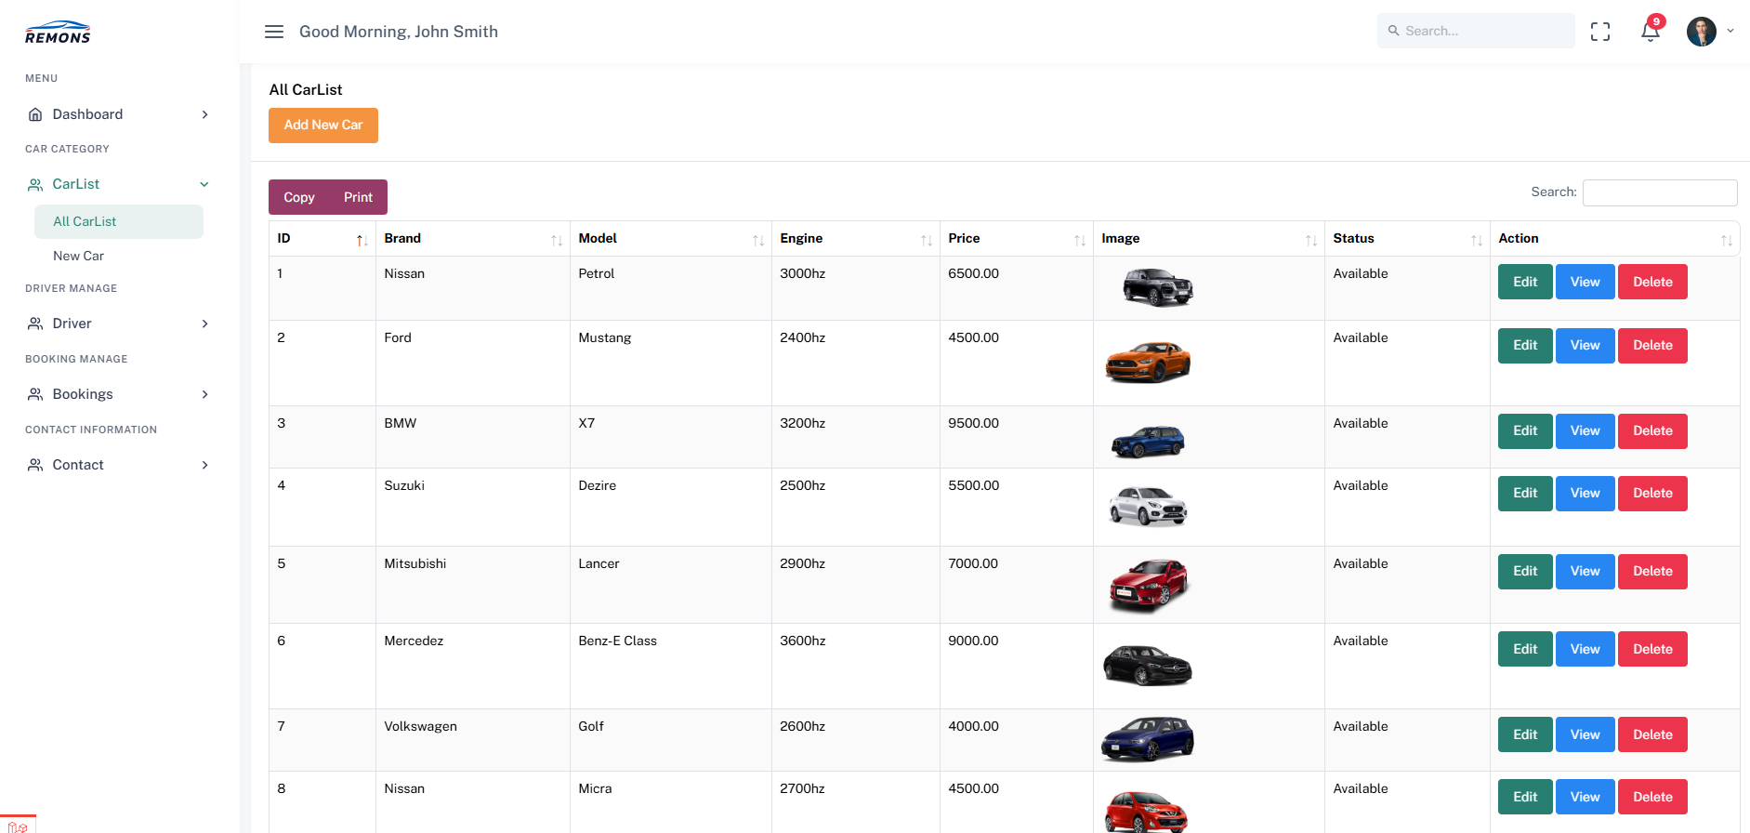

Slide 27
Admin Booking Manage

Slide 28
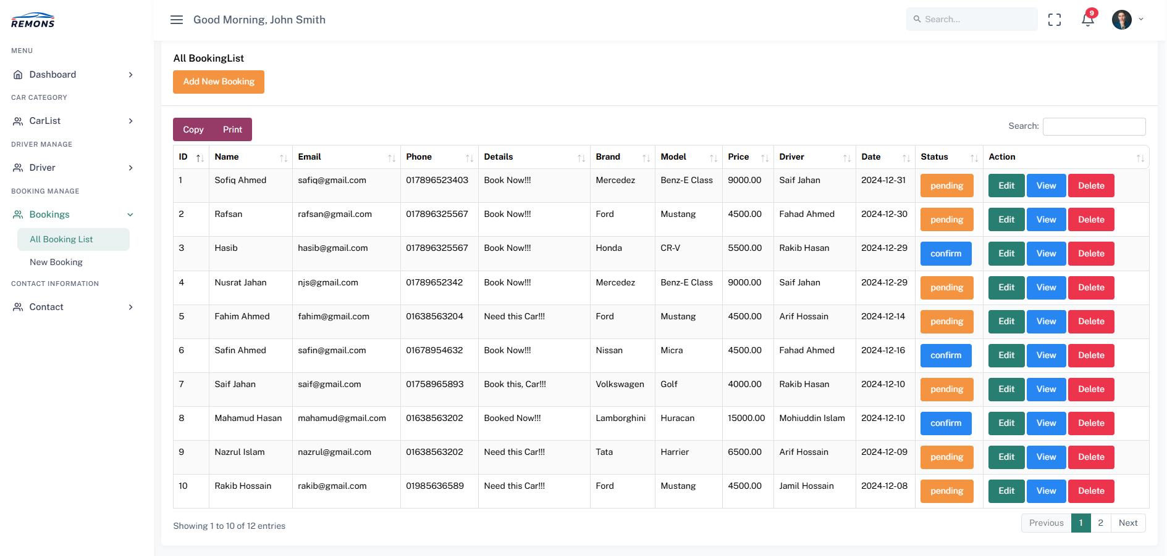

Slide 29
Thank You!!!

